Slide 1

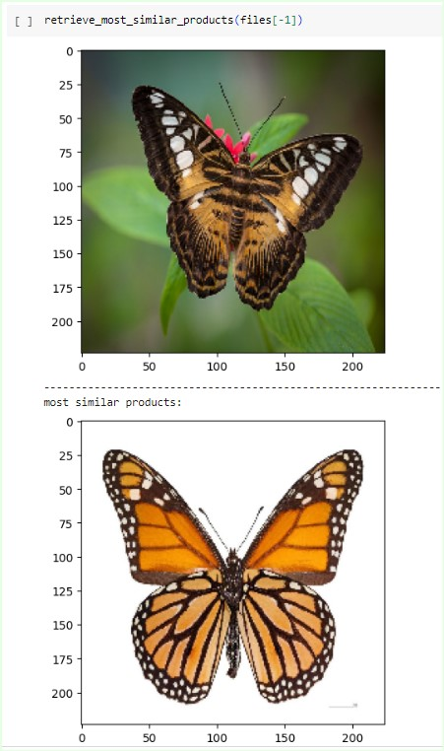
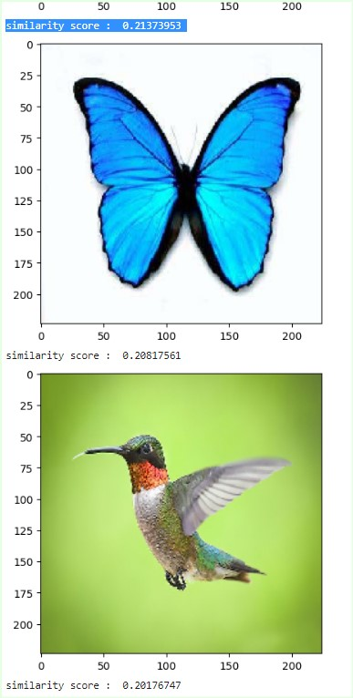
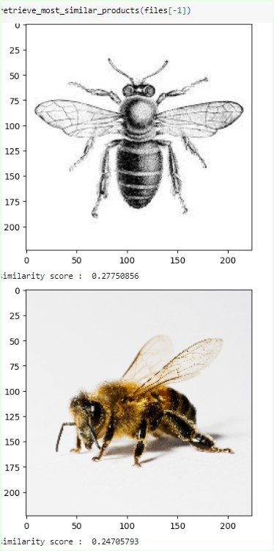
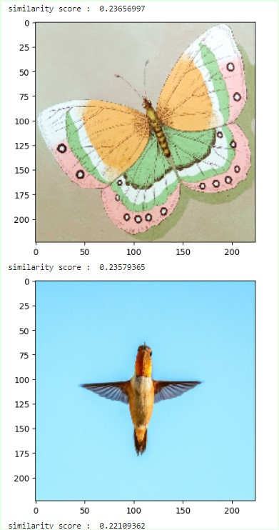
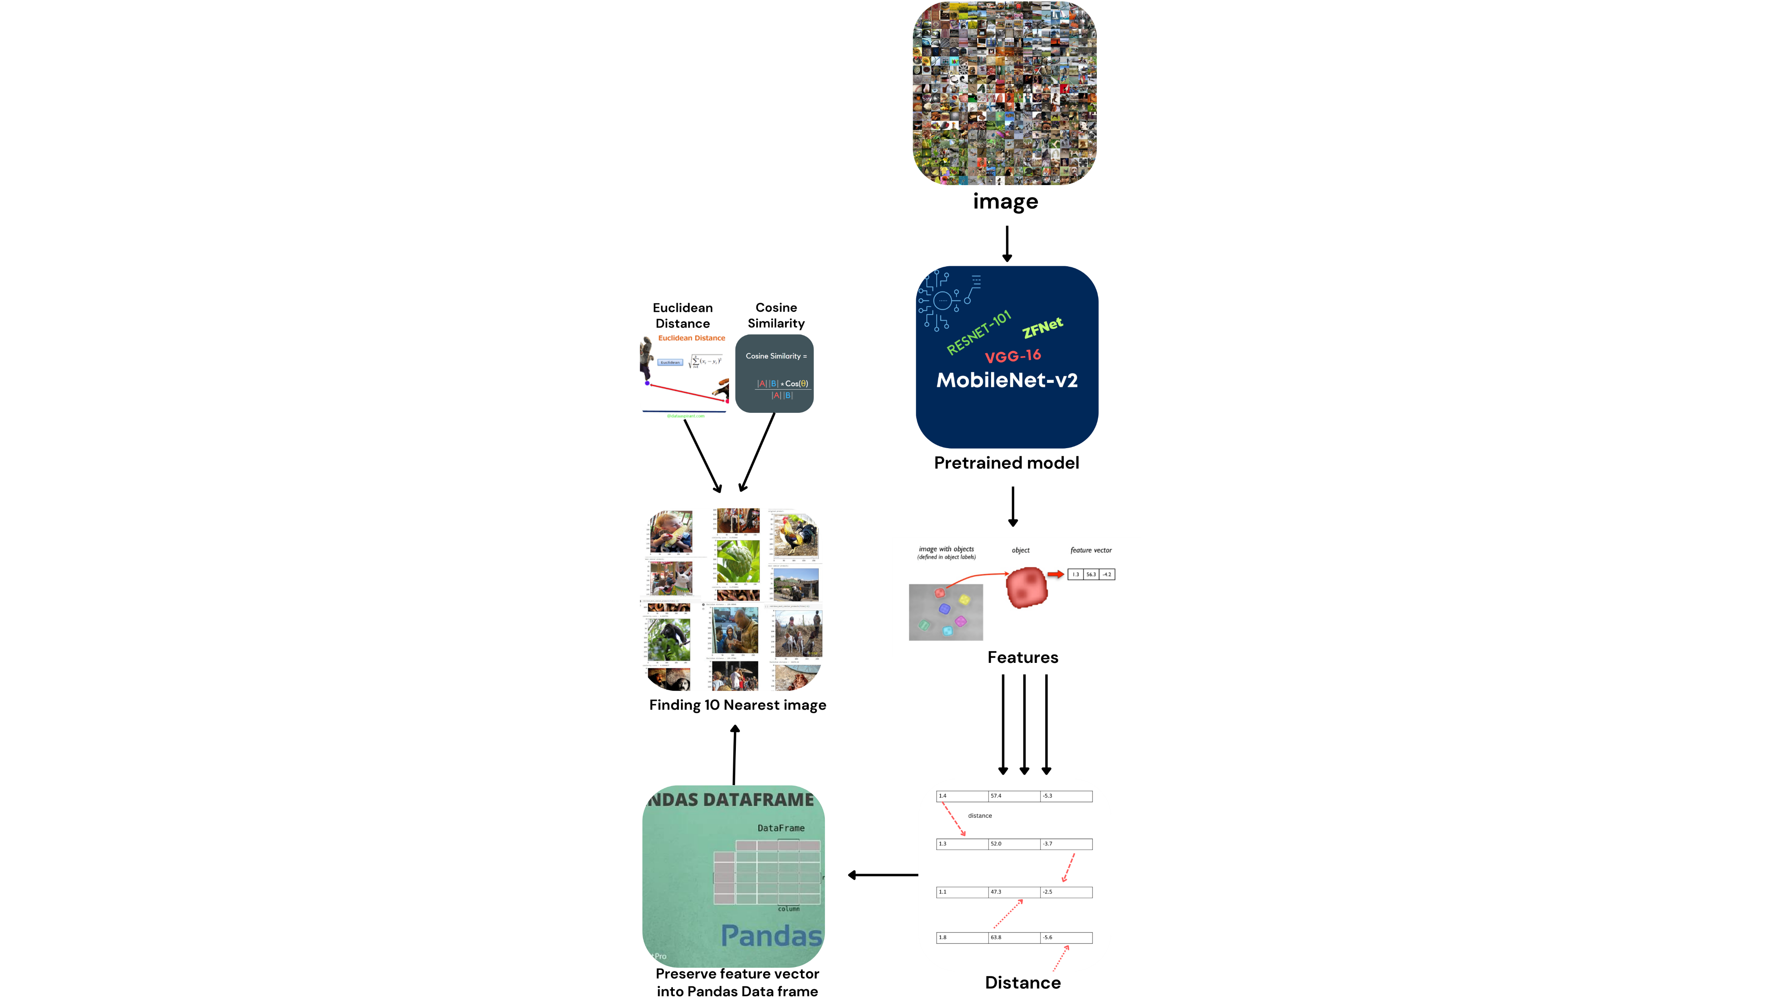
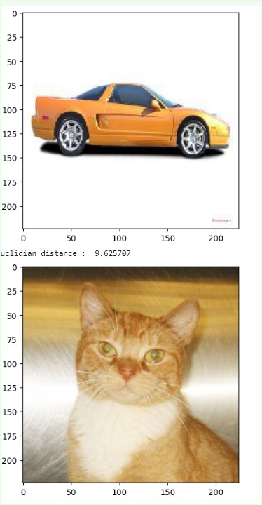
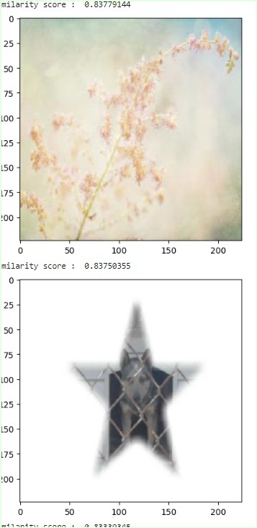
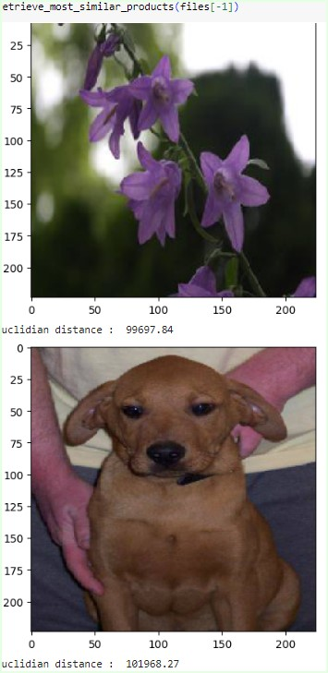
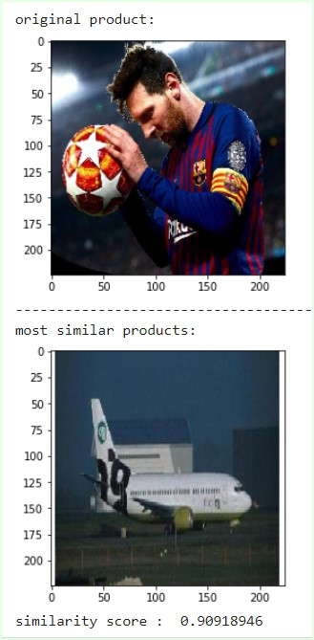
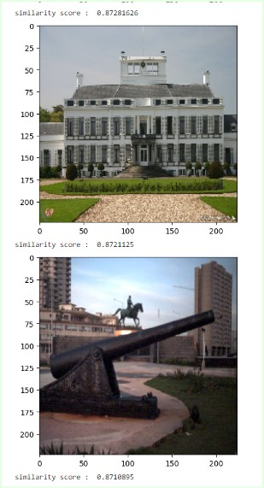
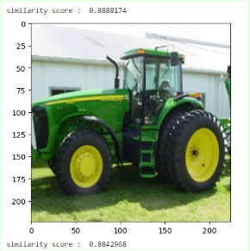
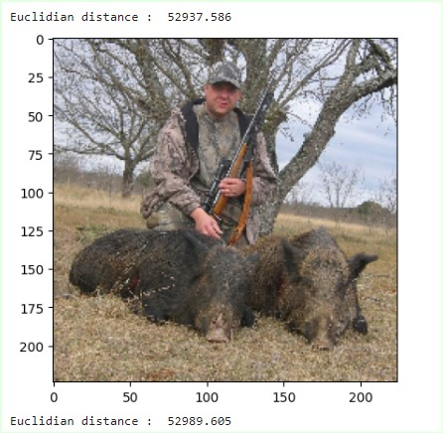
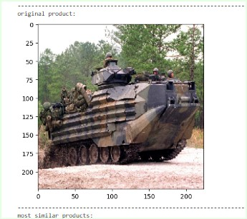
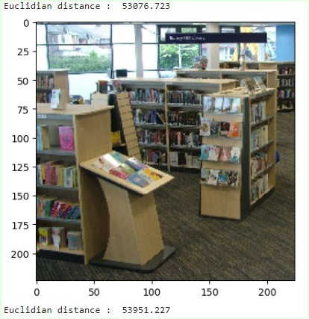
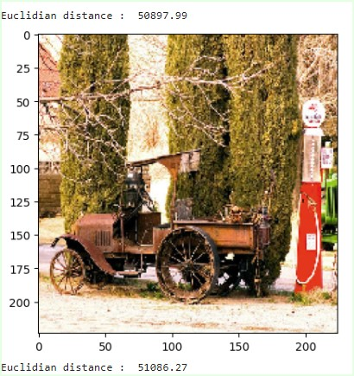
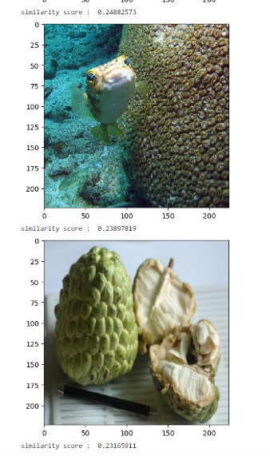
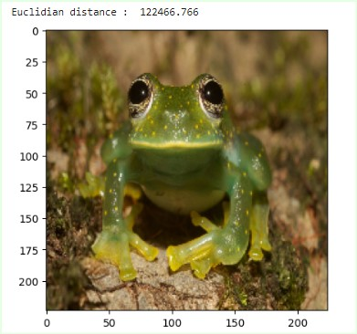
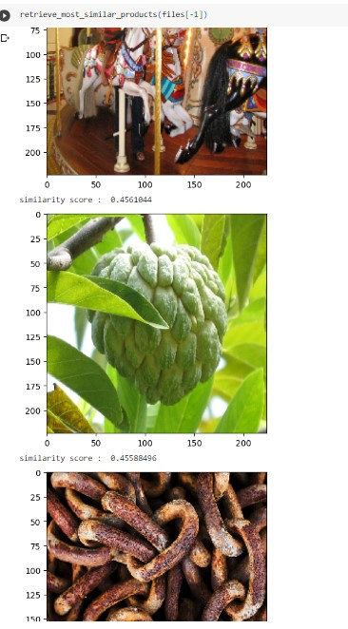
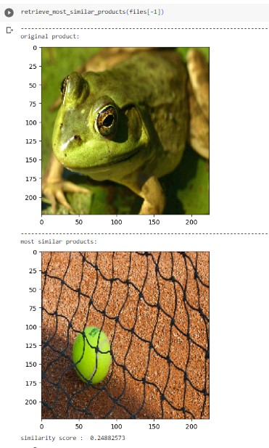
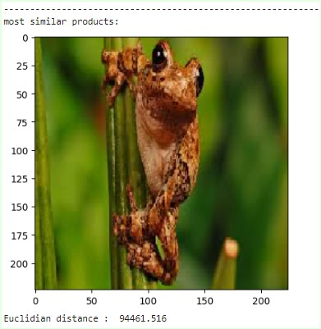
Nearest Neighbour of Different Image Representation
Sajid Wasif , Ankur Chowdhury
Faculty Advisor: Dr. MOHAMMAD ASHRAFUZZAMAN KHAN
ABSTRACT
Input image
Output images
This project presents a system that utilizes pretrained models and feature extraction techniques to identify similarities between images from different domains. Collecting a diverse dataset and computing feature vectors, the system measures distances using both Euclidean distance and cosine similarity. The retrieval system returns the top 10 images with the highest similarity scores, revealing hidden connections and showcasing the potential for cross-domain image similarity. This work has applications in content-based image retrieval, cross-domain analysis, and creative exploration.
In contrast to the input image, where objects may appear in their true form, object detection outputs can exhibit variations in size, shape, and nature, even for objects of the same species. This demonstrates the remarkable manipulation capabilities of feature vectors in object detection algorithms, allowing them to discern and categorize objects based on shared characteristics.
METHODOLOGY
Output images
Input image
The set of outputs indicates pixel values influence the object detection. Features that are collected are different by their properties and nature in contrast of the given image. Parts of the input image is extracted as feature vector and interesting outputs can be generated of different nature (object, animal etc.) which has similar feature same as the given input. This indicates similarity can be defined by many things which humans cannot simply tell or define but in actual case they are similar by their features (shown by this system). Outputs of this system are the clear example of similar things in nature which are totally different but similar to the object which not only humans can understand but also the system they make are able to make them understand.
ADD PHOTOS/VISUALS
TO ENHANCE THE APPEAL
OF YOUR POSTER
Output images
Input image
RESULT & ANALYSIS
Output images
Input image
Using feature vectors from images and resulting similar output shows how object detection can be varied with interesting similarities from different fields and gives an opportunity to explore and observe the similarities in a large scale which may seem not similar at all but in depth its actually very similar (using distance metrics to find similar features from the image data of our system) which with naked human eyes cannot be defined neither with any logic.
CONCLUSION
CONCLUSION
The system successfully demonstrated the use of pretrained models and feature extraction techniques to identify similarities between images from different types and nature. Computing feature vectors and measuring distances, the system accurately identified related images. The findings showcase the potential of cross-domain image similarity in applications such as content-based image retrieval and creative exploration. Further advancements and integration of deep learning techniques could enhance the system's performance and broaden its applications. Overall, this project may contribute to the field of cross-domain image analysis and provides valuable insights for future research and practical use.
NSU CAPSTONE PROJECT SHOWCASE, Spring, 2023

